Slide 1

BFPT Ultrasonics GmbH
Special Solution for Fish Farming Cleaning Process
Sarnen, Switzerland
8. January 2018
CONFIDENTIAL

Slide 2
Confidentiality & Non-Disclosure
2
This presentation contains proprietary and confidential information. All data and information submitted to the receiving party is provided in reliance upon its consent not to use or disclose any information contained herein except in the context of its business dealings with MPI. The recipient of this document agrees to inform present and future employees of receiving party who view or have access to its content of its confidential nature.
CONFIDENTIAL

Slide 3
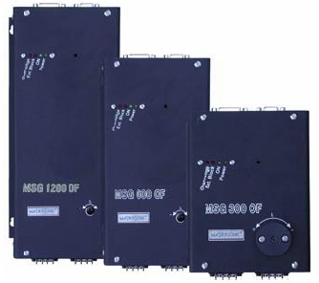
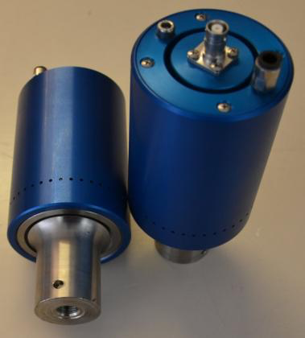
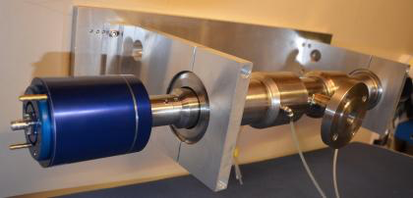
Technology
3
Patented Ultrasonic Generator
Patented Transducer Design
New Improved Applications
+
=
CONFIDENTIAL

Slide 4
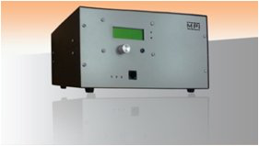
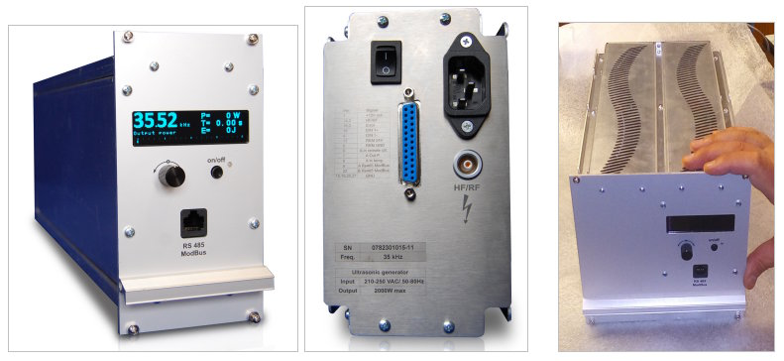
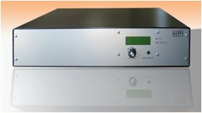
Technology (generator design)
4
MPI has developed the patented multi-frequency, multimode, modulated sonic & ultrasonic system (also known as MMM). The system generator represents a brand new approach in sonic and ultrasonic power supplies and equipment.
CONFIDENTIAL

Slide 5
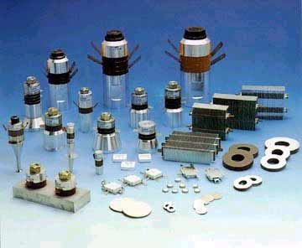
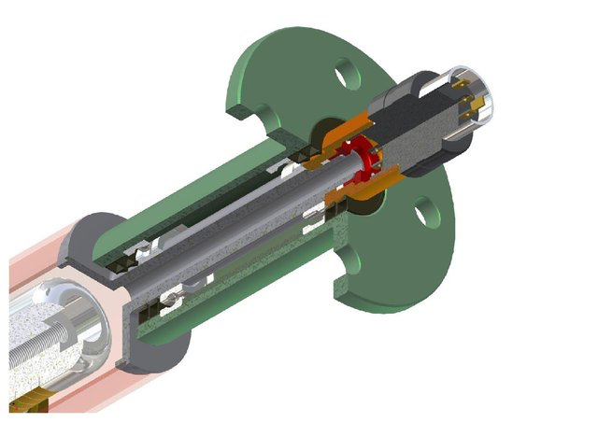
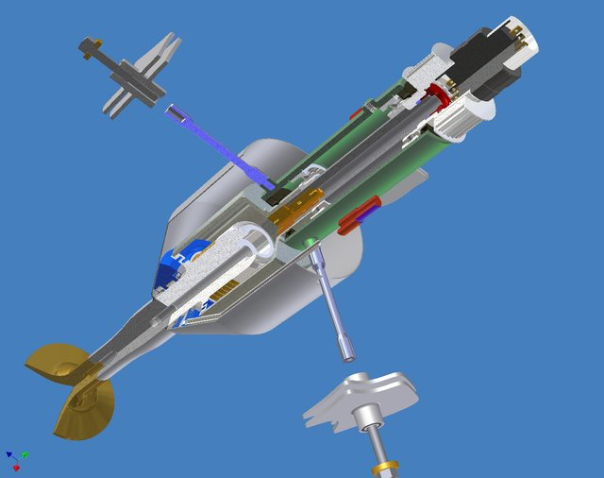
Technology (customized transducer design)
5
The unique MPI transducer is custom designed according to its application and is coupled according to patented methods. This, when applied in combination with the MMM generator, results in solutions giving rise to a vast expansion of possible applications and a vast improvement in its effectiveness.
CONFIDENTIAL

Slide 6
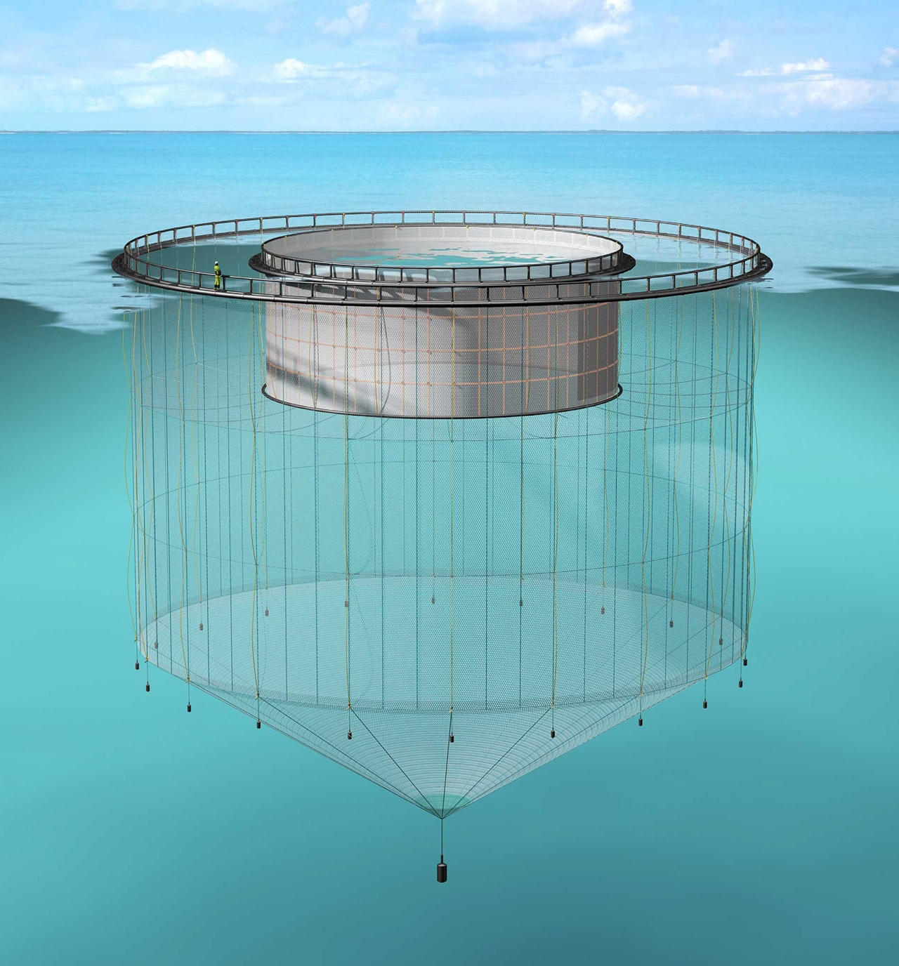
Applications “Fish Farming” (Acoustic Curtain)
6
Fish Farming devices are normally situated at sea and in Norway alone there are 40,000 such enclosures, each one having a product value of several million Euros. There are many unsolved problems of disease, fouling of nets and enclosures and of pollution in this industry . All existing cleaning methods and systems are very limited.
MPI has developed a ground-breaking solution.
Ongoing:
- Patent Application submitted in November 2017.
- Collaboration with Norwegian based Fish Farm supplier.
- Collaboration with Norwegian Research Council
- Collaboration with SINTEF R&D, Norway
Norwegian National Funding Project
CONFIDENTIAL

Slide 7
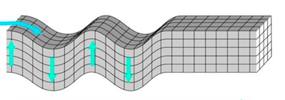

Applications “Fish Farming” (Acoustic Curtain)
8
acoustic transducer A
acoustic transducer B
vibration direction A
vibration direction B
A
A: amplitude of vibration,
a few micro meters
CONFIDENTIAL

Slide 8
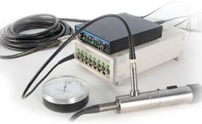
Applications “Fish Farming” (Acoustic Curtain)
7
acoustic transducer A
acoustic transducer B
sea water
vibration direction A
vibration direction B
sound pressure measurement
Hydrophone
width of effective zone
CONFIDENTIAL

Slide 9
Applications “Fish Farming” (Acoustic Curtain)
9
acoustic transducer part A
cylinder form and tube form have different vibration effect. The optimized shape of transducer will be investigated.
acoustic transducer part B
CONFIDENTIAL

Slide 10
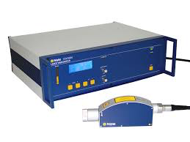
Applications “Fish Farming” (Acoustic Curtain)
10
The attenuation along the transducer part B will be investigated by using laser vibrometer.
laser vibrometer
laser vibrometer
acoustic transducer part A
acoustic transducer part B
p1
p2
p3
p4
p5
p6
p7
p8
p9
p10
Amplitude (micrometer)
distance (meter)
p1
p2
p3
p4
p5
p6
p7
p8
p9
p10
CONFIDENTIAL

Slide 11
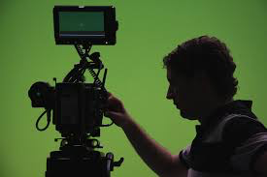
Applications “Fish Farming” (Acoustic Curtain)
11
generator 3
generator 1
generator 2
testing option 3
testing option 2
testing option 1
Parameters for options:
frequency
acoustic power
time duration of illumination
wire forms
CONFIDENTIAL

Slide 12
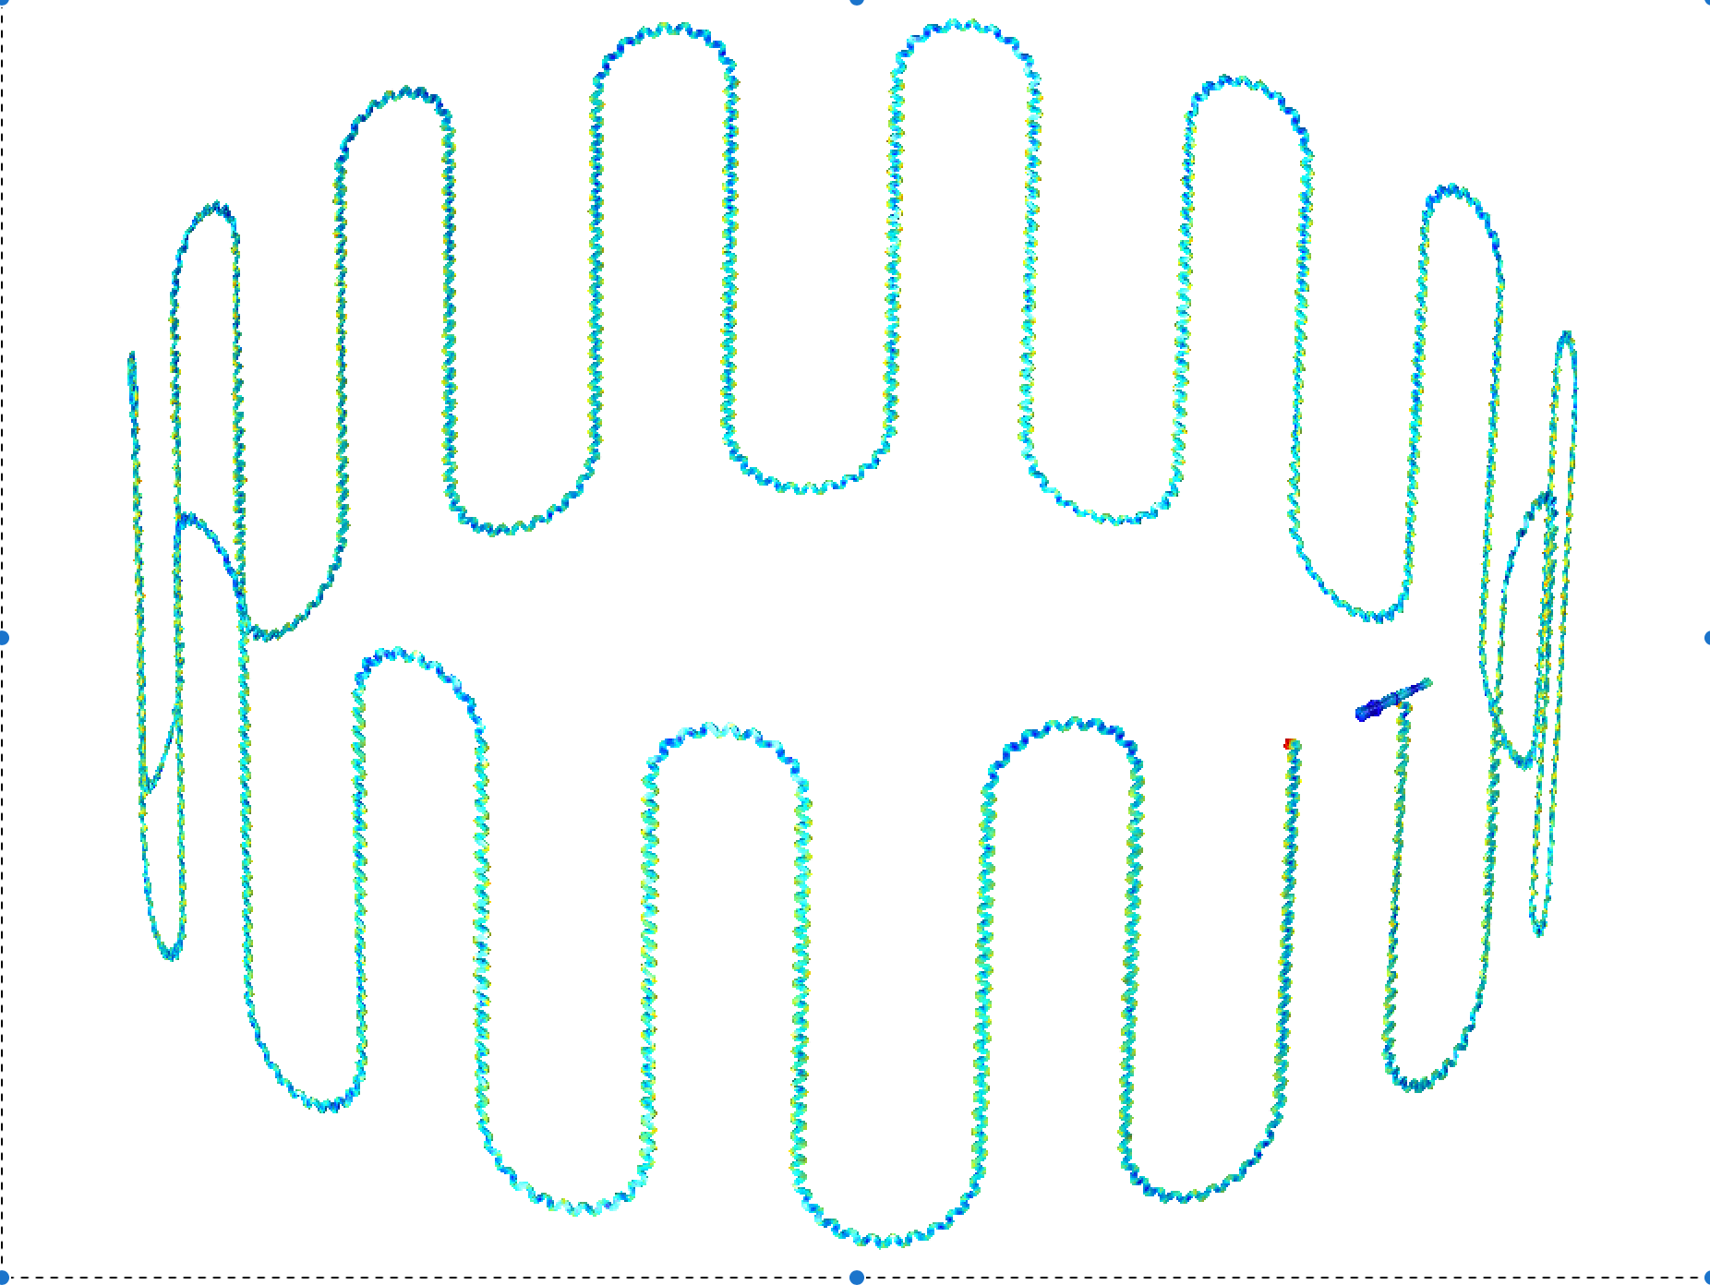
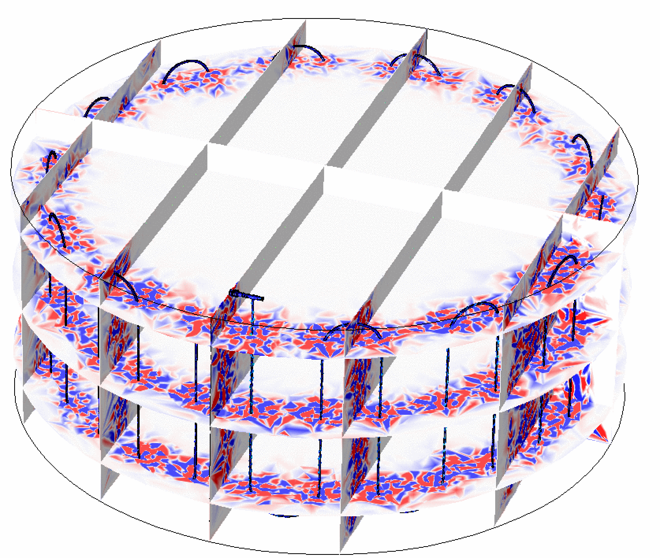
Applications “Fish Farming” (Acoustic Curtain)
12
Simulation for transducer (main part, part A)
Simulation for wire transducer (part B)
Simulation for forming of wire transducer
CONFIDENTIAL

Slide 14
Thank You
14
CONFIDENTIAL

